Slide 1
Environmental Sensor Data Analysis
Sanket Janolkar
Gautam Nair
Apoorva Dharadhar
Izhar Khan
Notes:
ID=d924773e-9a16-4d6d-9803-8cb819e99682 Recipe=text_billboard Type=TextOnly Variant=0 FamilyID=AccentBoxWalbaum_Zero

Slide 2

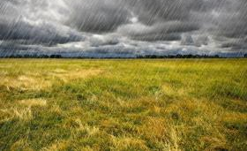
Introduction
In an era where environmental changes are becoming increasingly unpredictable, there is a critical need to better understand and forecast these changes to mitigate their impacts effectively. This project aims to tackle this challenge by constructing a data pipeline that processes environmental sensor data to enable advanced analytics and predictive modelling. By analyzing this data, we can identify trends and patterns that help in predicting environmental conditions, ultimately contributing to more informed decision-making in environmental policy and management.

Slide 3
Data Engineering Goals
Efficient Data Ingestion and Storage: To extract data from diverse sources such as GitHub repository and API and store it reliably in Azure Data Lake.
Automated Data Workflow Management: Utilizing Apache Airflow to orchestrate data processing, ensuring data integrity and timeliness.
Robust Data Processing and Transformation: Data processing tasks, including cleaning, normalization, and feature engineering to prepare data for analysis.
Scalable Data Analytics and Machine Learning Deployment: To analyze the processed data for insights and predict future environmental trends using machine learning models.

Slide 4

Downstream Consumers
Environmental Agencies and Policymakers: Who require detailed reports and forecasts to make informed decisions regarding environmental management and legislation.
Research Institutions: That could use the data for academic research and the development of more advanced environmental prediction models.
Public and Community-Based Organizations: Interested in understanding local environmental trends to advocate for community-specific actions.

Slide 5
Technologies and Methodology
Google Colab: This is where data ingestion and transformation take place, here we have extracted the data from the GitHub repository that has the flat.
Apache Airflow: Is used to manage the workflow, specifically to trigger the API call, the data from which is used for weather forecasting for the future dates.
Azure Data Lake: The transformed data is stored in the Data Lake. In Azure, we established a resource group named 'environmental_data_analysis' to facilitate our project endeavours.
Databricks: Databricks provides tools that help you connect your data sources to one platform to analyze datasets.

Slide 6
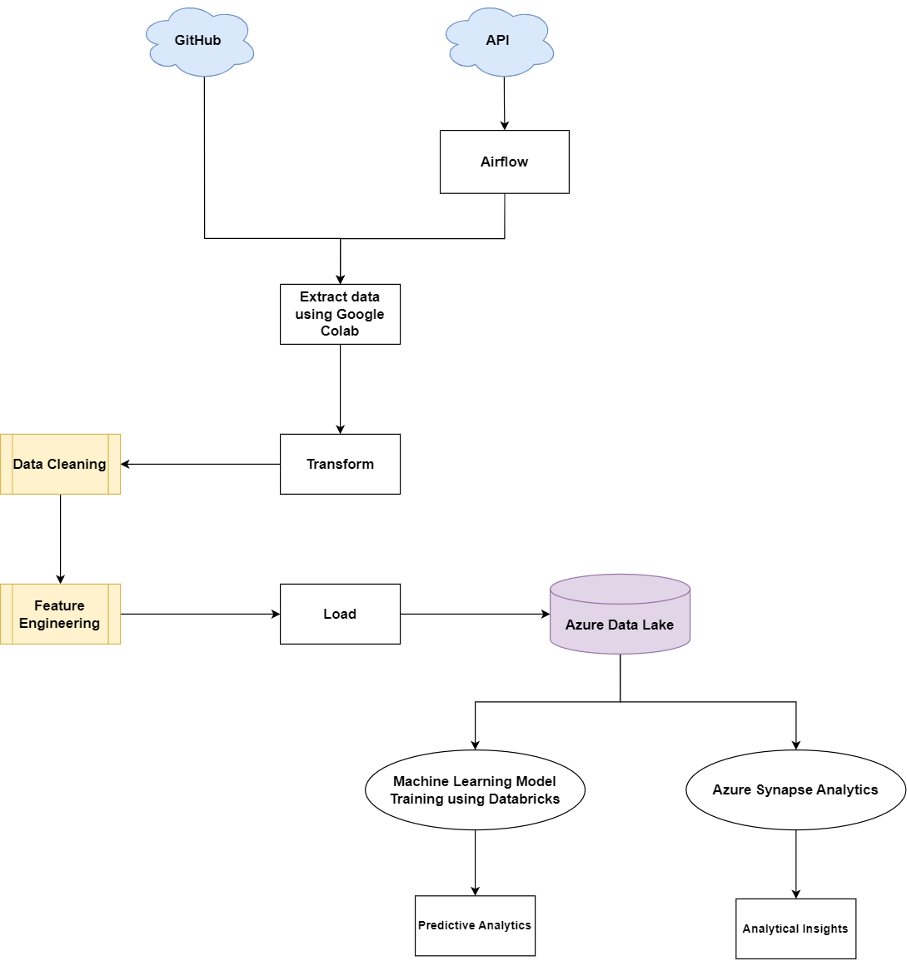
Workflow Diagram

Slide 7
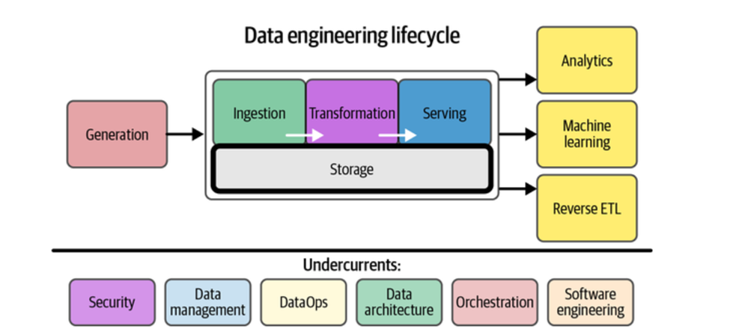
Data Engineering Lifecycle

Slide 8
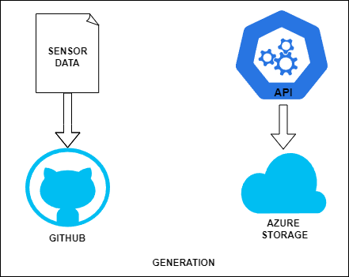
Generation
Data for the project sourced from Visual Crossing Weather Data website includes historical and real-time data.
Historical weather data, covering six years, is stored in flat file format on GitHub for accessibility.
Real-time weather data is captured directly via an API and stored in the Azure Data Cloud for immediate availability and scalability.
This dual-source approach allows for a comprehensive analysis of weather patterns by combining long-term historical insights with up-to-the-minute data observations.

Slide 9
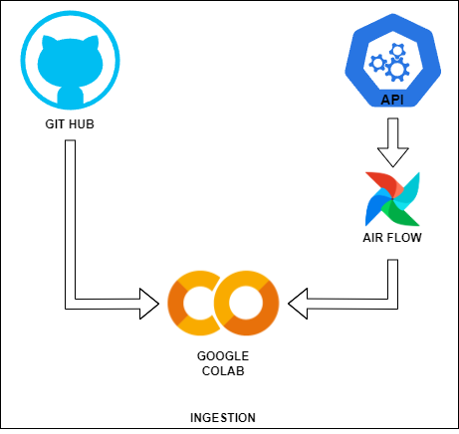
Ingestion
In the Google Colab environment, data is retrieved from the GitHub repository .
Apache Airflow is utilized to manage the retrieval of real-time data via an API.

Slide 10
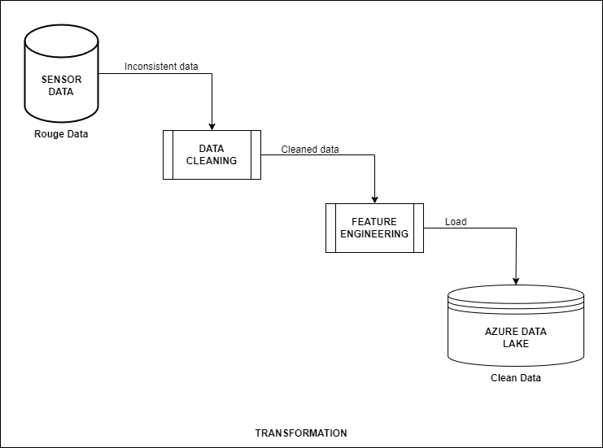
Transformation
During the data cleaning phase, several transformations were made to streamline the dataset.
Unnecessary columns irrelevant for predictive modelling were removed.
The ‘datetime’ column, initially formatted as a string, was converted into the datetime data type.
These transformations were vital for enhancing the dataset's accuracy and effectiveness in predictive analytics.

Slide 11
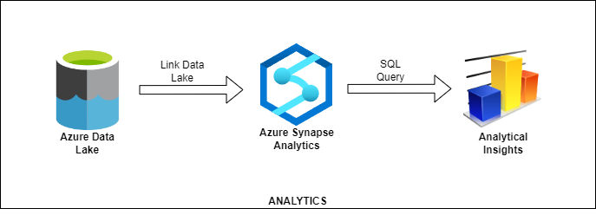
Analytics
The data was pulled from the Azure Data Lake and then it underwent visualization processes within Synapse Analytics, where SQL queries were employed to extract insights such as year-wise average temperature and precipitation

Slide 12
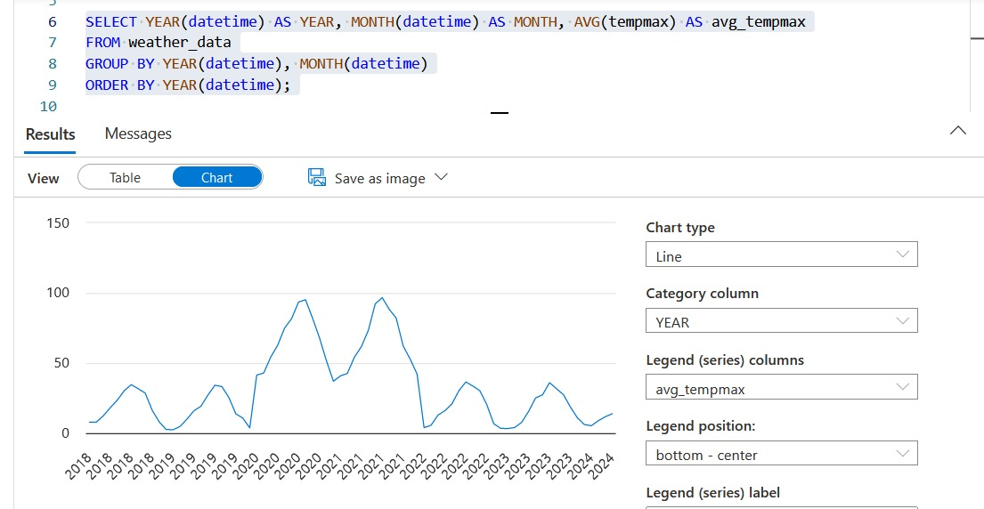
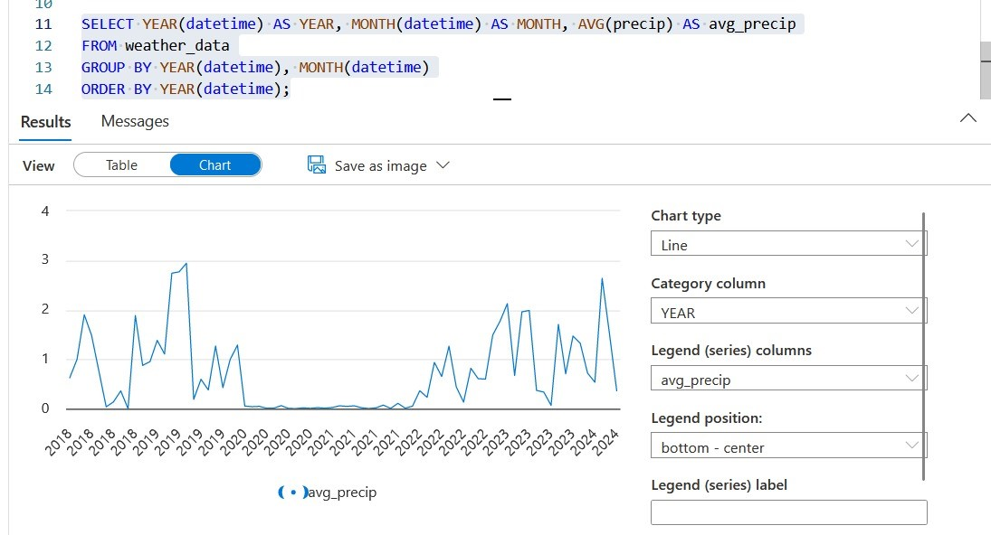
Analytics

Slide 13
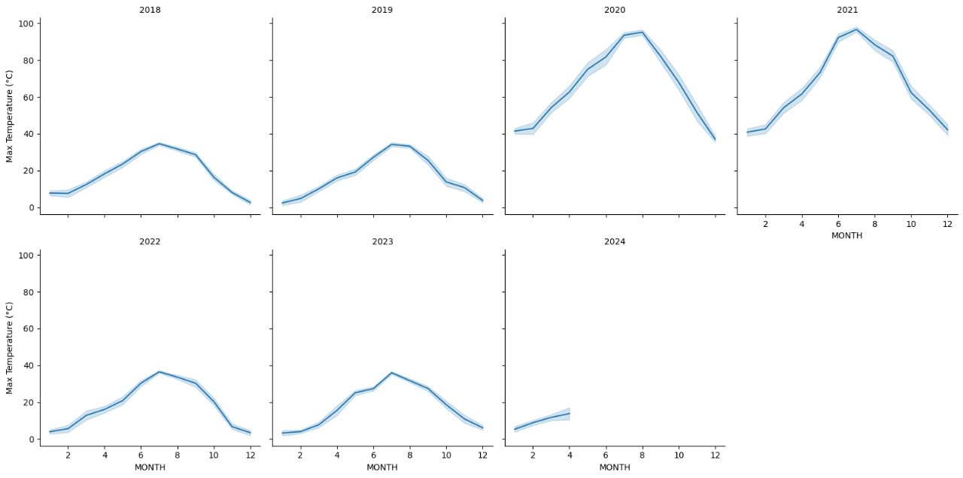
Analytical Insights
The above line graph showing the weather trends

Slide 14
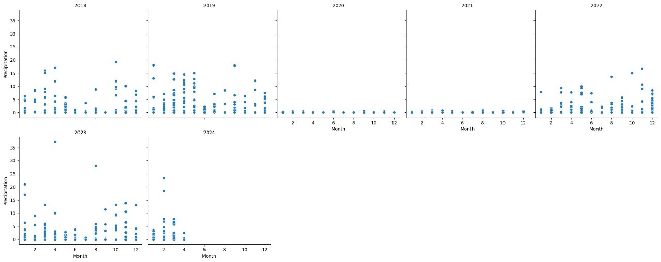
Analytical Insights
The above Scatter plot indicates the amount of precipitation across the years

Slide 15
Machine Learning
Naive Bayes: A probabilistic classifier based on Bayes' theorem, achieving an accuracy of 86% in our testing.
K-Nearest Neighbors (KNN): A non-parametric algorithm that classifies objects based on their nearest neighbors, also achieving an accuracy of 86% in our evaluation.
Decision Tree: A tree-like model where decisions are made based on features at different branches, showing a perfect accuracy of 100% in our testing but potentially indicating overfitting, where the model may not generalize well to new data.

Slide 16
Weather Predictions
Machine Learning Model
Weather App – The Weather Channel

Slide 17
Future Scope
Shift to real-time data streaming architectures using technologies such as Apache Kafka or AWS Kinesis to enhance responsiveness.
Explore sophisticated AI techniques like deep learning and reinforcement learning to improve prediction accuracy.
Develop interactive visualization tools using platforms like Power BI or Tableau to make insights more accessible and actionable.

Slide 18
Thank You

